Slide 1


Python Fundamentals
Innovation Masters
Day 15

Slide 2
Today’s Agenda
Learn how to measure time
Learn how to generate random numbers
ASCII Characters
Generate random strings
Make a typing game on your own

Slide 3
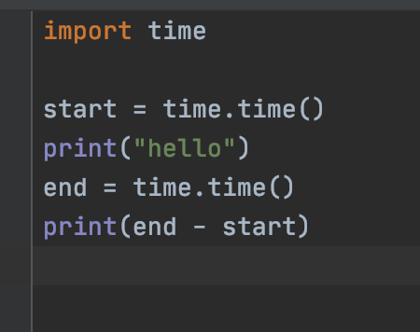
How to get elapsed time
When this code is run it will tell us how long in seconds it took to print “Hello”
We can use this to get elapsed time for any code

Slide 4
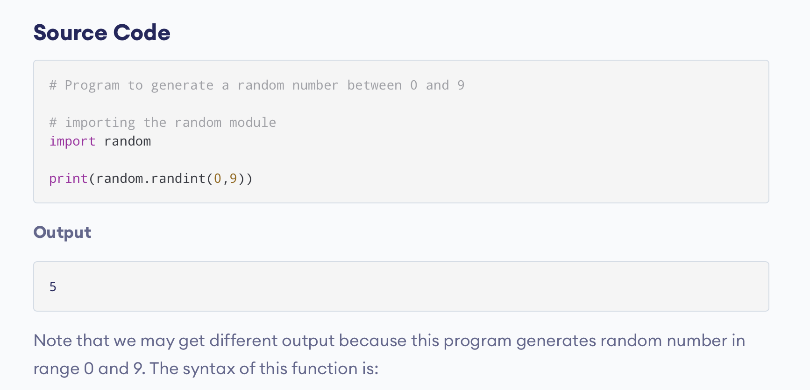
Random numbers

Slide 5
ASCII Characters
American Standard Code for Information Interchange
Computers only understand numbers
All the characters have a numerical representation
All American programming languages follow the same numeric representation
Example: “A” is 65, “x” is 120

Slide 6
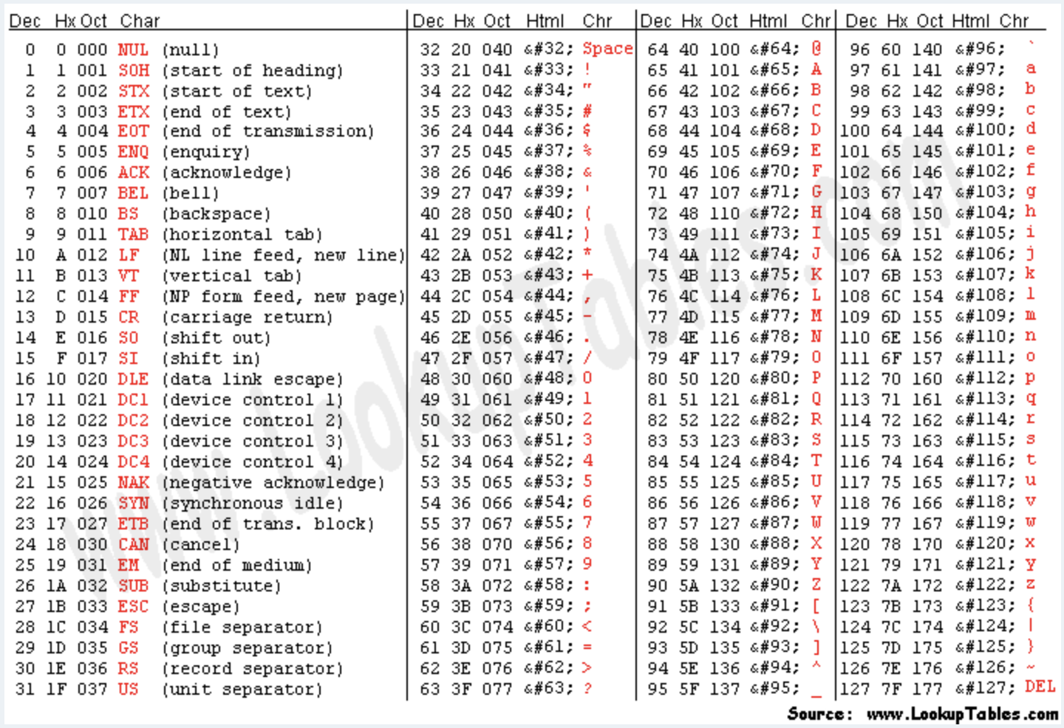
ASCII Table

Slide 7
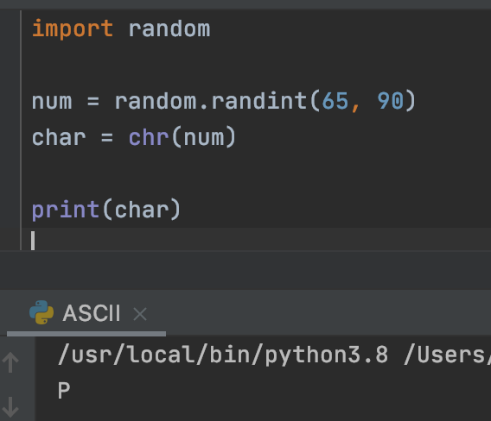
Generate random String using ASCII
A-Z => 65-90
a-z => 97-122
Chr method takes an integer number and converts it into the according character

Slide 8
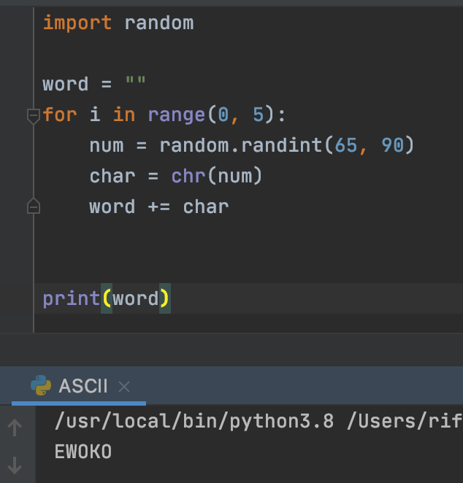

Use a loop to make string
Output

Slide 9
Fast Typer
Make a type testing game
Program will generate a random string
User has to type that string as fast as they can
Program will tell user how long it took for them to type
If the user types incorrectly, let them know

Slide 10
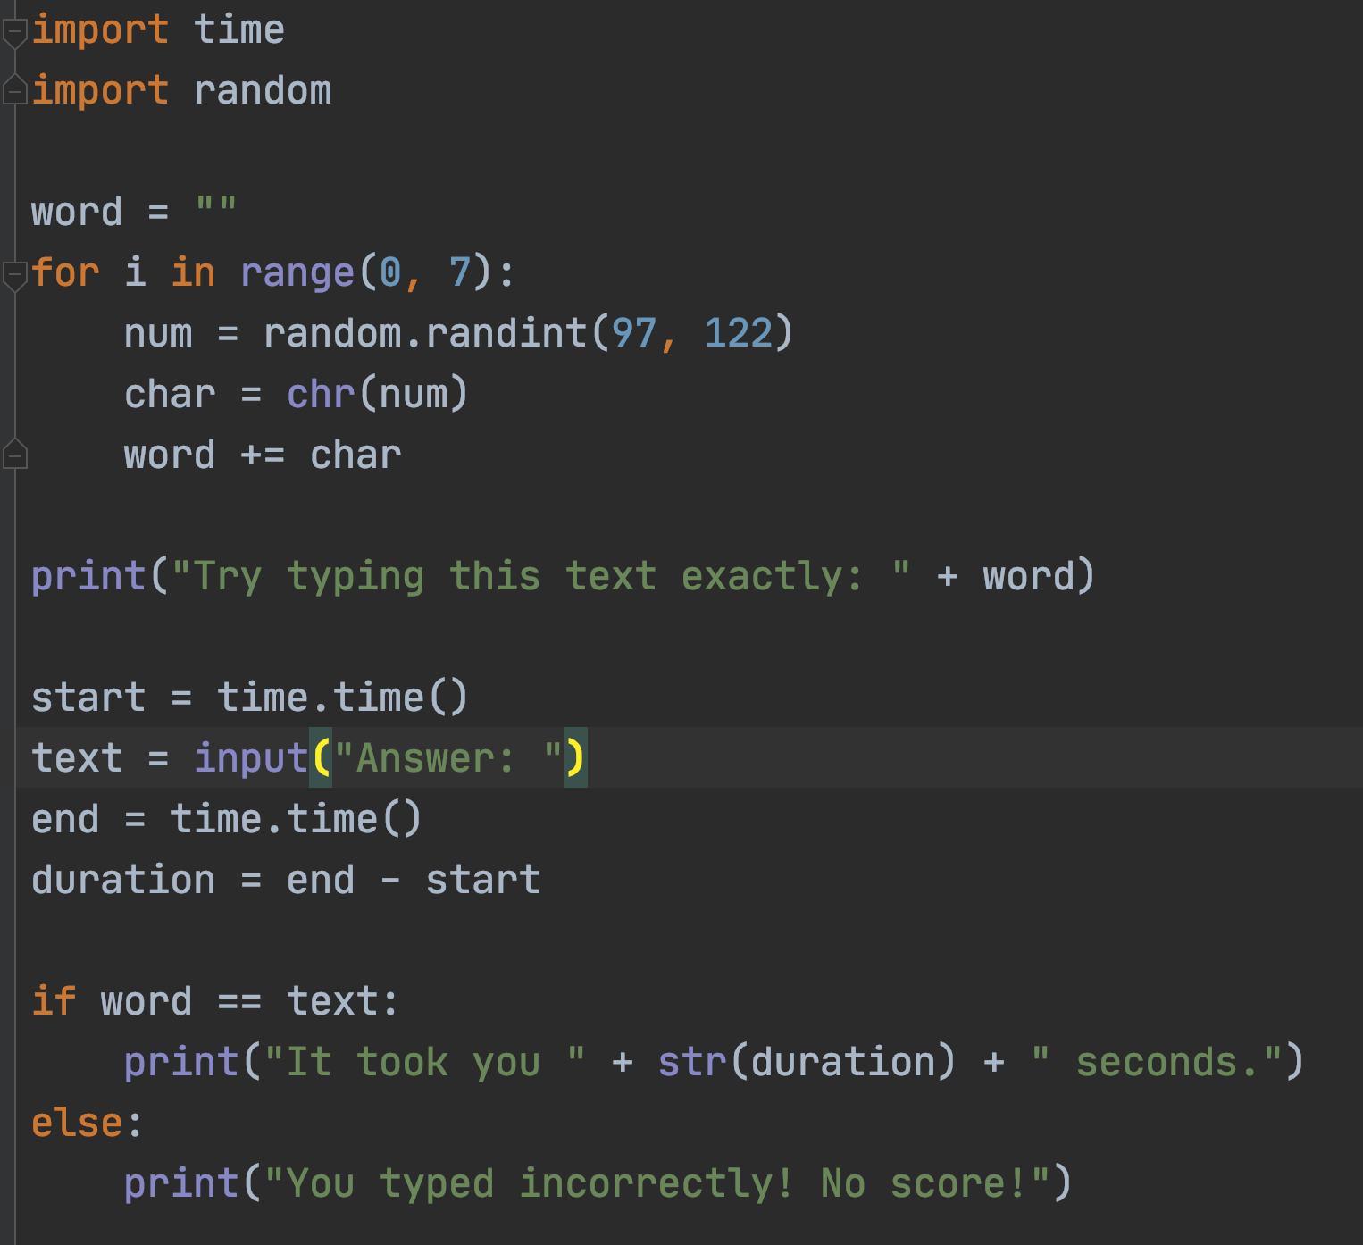
Solution

Slide 11
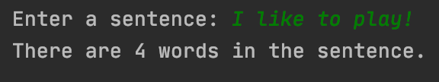
Homework- Word Counter
Take a string input from user
Count how many words there are in the string
Example input/output
Input
Output

Slide 12
Tech Talk
Show
Today I will show you guys a little about animation
Create
You can create simple animations very easily and quickly
Use
Use these tools to have fun and also to create content for your business or YouTube channel

